Slide 1
Case study for
“{simulationInput.caseStudy.company}“ / “{simulationInput.ship.name}”
{#simulationInput.caseStudy.rotorSails}{amountText} {height}m x {diameter}m Norsepower Rotor Sails™ on {type} foundation{amount > 1 ? "s" : ""}{/simulationInput.caseStudy.rotorSails}.
{date}

Slide 2
Contents
Executive summary
Simulation inputs
Fuel and emission savings
Impact in IMO and EU regulation
Indicative pricing & business case
Suggested next steps

Slide 3
Introduction
Norsepower has carried out a customized performance simulation based on “{simulationInput.ship.name}” data. In this case study we present the predicted fuel an emission savings, benefits due to regulation compliance and the business case calculations for project of installation of Norsepower Rotor Sails™ in your vessel.
The case study is based on:
Full-scale performance measurement of Norsepower rotor sails in operation at sea.
Ship specific technical data and operational profile.
20 years of historical global wind data from European Union Space program
IMO and EU regulation framework
Norsepower Rotor Sails™ performance has been extensively tested and verified by third parties such as LR, ABB, DNV, NAPA and SSPA/RISE, during measurements campaigns in several ship’s installations.

Slide 4
Executive Summary

Slide 5
Executive Summary
The expected capex for the proposed configuration is {simulationResults.rotorSailsSummary.sumPrice | toFixed:0 | thousandsSeparator} USD.
The expected annual fuel savings are {simulationResults.combinedSavings.averageRouteFuelSavings | toFixed:0 | thousandsSeparator} tons.
Total net annual savings (including OPEX) from {simulationResults.fuelPrice.fuelCostSavingMinFuel.fuelCostSaving | toFixed:0 | thousandsSeparator} to {simulationResults.fuelPrice.fuelCostSavingMaxFuel.fuelCostSaving | toFixed:0 | thousandsSeparator} USD per year.
Payback period from {simulationResults.fuelPrice.fuelCostSavingMaxFuel.paybackPeriod | toFixed:2} to {simulationResults.fuelPrice.fuelCostSavingMinFuel.paybackPeriod | toFixed:2} years.
Accumulated net savings of {simulationResults.fuelPrice.fuelCostSavingMaxFuel.cumulativeNetAnnualSavings[25] / 1000000 | toFixed:1} million USD for the whole lifetime of the sails (25 years)

Slide 6
Simulation input

Slide 7
Proposed sails configuration:
{#simulationInput.caseStudy.rotorSails}{amountText} {height}m x {diameter}m Norsepower Rotor Sail{amount > 1 ? "s" : ""}™ on {type} foundation{amount > 1 ? "s" : ""}{/simulationInput.caseStudy.rotorSails}.
Ship length: {simulationInput.ship .length | toFixed:1} m
Beam: {simulationInput.ship.width | toFixed:1} m
Laden draft: {simulationInput.ship.ladenDraft | toFixed:1} m
Ballast draft: {simulationInput.ship.ballastDraft | toFixed:1} m
Installation height: {simulationInput.ship.installationHeight | toFixed:1} m
Preliminary sketch: Vessel with {#simulationInput.caseStudy.rotorSails}{amountText} {height}m x {diameter}m Norsepower Rotor Sail{amount > 1 ? "s" : ""}™ on {type} foundation{amount > 1 ? "s" : ""}{/simulationInput.caseStudy.rotorSails}

Slide 8
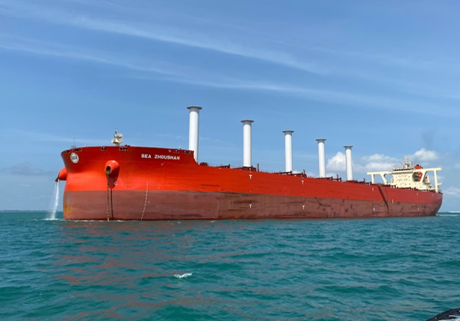
Ship operation profile
Parameters
Total propulsion efficiency [%] | {(simulationInput.ship.propulsionEfficiency | toFixed:1) * 100}
Time-at-sea [%] | {(simulationInput.caseStudy.timeAtSeaRatio) * 100 | toNearest:0.1}
Service speed laden [knots] | {simulationInput.ship.ladenServiceSpeed | toFixed:1}
Service speed ballast [knots] | {simulationInput.ship.ballastServiceSpeed | toFixed:1}
Fuel type | {simulationInput.ship.fuelType.abbreviation}
Prop. Power laden [kW] | {simulationInput.ship. ladenServicePower | toFixed:0}
Prop. Power ballast [kW] | {simulationInput.ship.ballastServicePower | toFixed:0}
SFOC [g/kWh] | {simulationInput.ship.sfoc | toFixed:0}

Slide 9
Fuel and emission savings

Slide 10
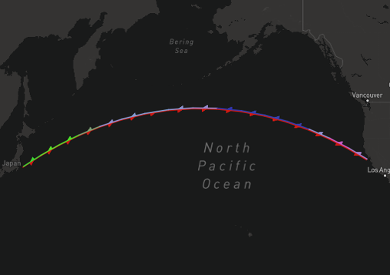
{:simulationResults.routes}
Performance on route: {name}
{#legendNumbers}
{.} kW
{/legendNumbers}
{name} ({twoWay ? ‘roundtrip’ : ‘one-way’}) {twoWay} | {legs.features[0].properties.oneWaySpeed} kn ({legs.features[0].properties.oneWayState == 'LADEN' ? 'laden' : 'ballast'}){#twoWay} / {legs.features[0].properties.returnSpeed} kn ({legs.features[0].properties.returnState == 'LADEN' ? 'laden' : 'ballast'}){/twoWay}
Weight of the route, % | {weight} {(weight * 100) | toNearest:0.1}
Average net savings, kW | {combinedRouteSavings.averageNetSavings| toFixed:0}
Average net savings, % | {combinedRouteSavings.averageNetSavingsPercentage|toFixed:1}
Average power consumption, kW | {combinedRouteSavings.averagePowerConsumption|toFixed:0}
Annual fuel savings, Tons | {combinedRouteSavings.annualFuelSavingsInTons|toFixed:0}
Annual CO2 reduction, Tons | {combinedRouteSavings.annualCO2SavingsInTons|toFixed:0}

Slide 11
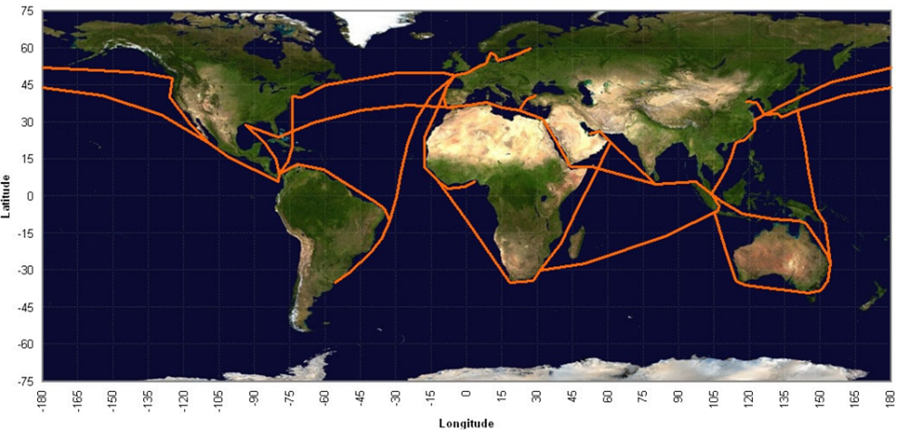
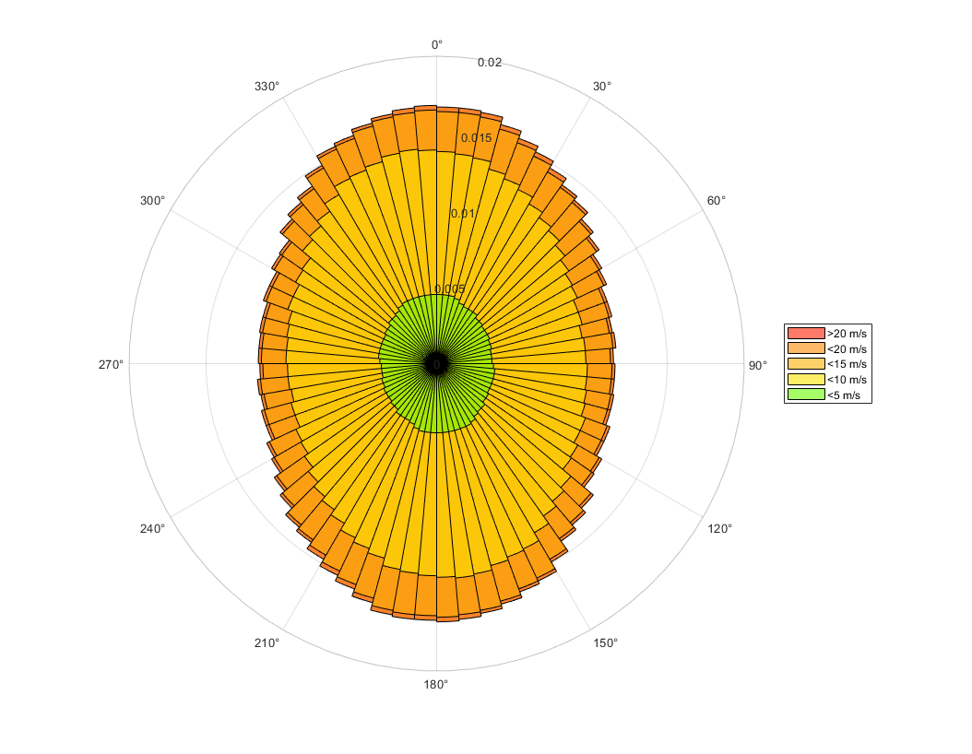
Performance in
Global average wind conditions
Global average wind conditions | {simulationInput.ship.ladenServiceSpeed | toFixed:1} kn
Average net savings, kW | {simulationResults.globalAverageRouteSavings.averageNetSavings | toFixed:0 }
Average net savings, % | {simulationResults.globalAverageRouteSavings.averageNetSavingsPercentage|toFixed:1}
Average power consumption, kW | {simulationResults.globalAverageRouteSavings.averagePowerConsumption|toFixed:0}
Annual fuel savings, Tons | {simulationResults.globalAverageRouteSavings.annualFuelSavingsInTons|toFixed:0}
Annual CO2 reduction, Tons | {simulationResults.globalAverageRouteSavings.annualCO2SavingsInTons|toFixed:0}
Propulsion savings in global average wind conditions calculated following the guidelines of MEPC.1/Circ.815, with Vref equivalent to laden service speed. The propulsion savings are compared to the laden propulsion power

Slide 12
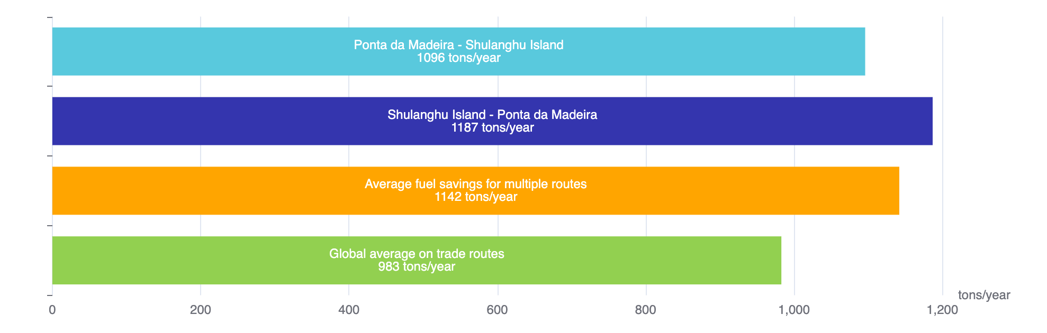
Comparison of savings per route
Weighted average of the simulated routes
Average net savings for multiple routes, kW | {simulationResults.combinedSavings.averageRouteNetSavings | toFixed:0 }
Average fuel savings for multiple routes, Tons | {simulationResults.combinedSavings.averageRouteFuelSavings | toNearest:1}
Average Main engine power for multiple routes, kW | {simulationResults.combinedSavings.averageRouteMainEnginePower|toFixed:0}
Average Main Engine fuel consumption for multiple routes, Tons | {simulationResults.combinedSavings.averageRouteMainEngineFuelConsumption| toNearest:1}
Average Savings percentage for multiple routes, % | {simulationResults.combinedSavings.averageRouteNetSavingsPercentage * 100 |toFixed:1}
Average annual CO2 Savings for multiple routes, Tons | {simulationResults.combinedSavings.weightedAnnualCO2SavingsInTons | toNearest:1}
Fuel cost savings (Low fuel cost scenario {simulationResults.fuelPrice.fuelCostSavingMinFuel.fuelPrice} USD/ton – High fuel cost scenario {simulationResults.fuelPrice.fuelCostSavingMaxFuel.fuelPrice} USD/ton), USD | {simulationResults.fuelPrice.fuelCostSavingMinFuel.fuelCostSaving | toNearest:100 | thousandsSeparator} - {simulationResults.fuelPrice.fuelCostSavingMaxFuel.fuelCostSaving | toNearest:100 | thousandsSeparator}
Annual fuel savings (tons/year)

Slide 13
IMO and EU regulations

Slide 14
FuelEU Maritime regulatory benefit (1/2)
FuelEU reward factor f_{Wind} :
EEDI/EEXI available effective power: f_{eff} * P_{eff} = P_{wind} = {simulationResults.EEDIReduction | toFixed:0 } kW.
EEDI/EEXI Propulsion power of the vessel: P_{ME} = P_{Prop} = {simulationInput.ship.pme | toFixed:0 } kW.
P_{wind}/P_{prop} = {simulationResults.GHG.ratio | toFixed:3 } ⇒ reward factor f_{Wind} = {simulationResults.GHG.fwind}
GHG Intensity without wind propulsion using {simulationInput.ship.fuelType.abbreviation} = {simulationInput.ship.fuelType.ghgIntensity} gCO₂eq/MJ.
GHG Intensity with Norsepower rotor sails = GHG Intensity * f_{Wind} = {simulationResults.GHG.intensityWithRotorSails | toFixed:2 } CO_{2eq}/MJ.
GHG Intensity target for 2025-2030: {simulationResults.GHG.target.intensity} gCO2eq/MJ.
GHG Intensity balance without wind propulsion = Target – GHG intensity = {simulationResults.GHG.balance.valueWithoutWindPropulsion | toFixed:2} gCO₂eq/MJ
GHG Intensity balance with Norsepower rotor sails = Target – GHG intensity = {simulationResults.GHG.balance. valueWithRotorSails | toFixed:2} gCO₂eq/MJ

Slide 15
FuelEU Maritime regulatory benefit (2/2)
Without wind propulsion:
Fuel consumption in EU/EEA area considering operational profile: {simulationResults.GHG.fuelConsumedInEuropeInTons | toFixed:0 } tons of MDO.
Compliance balance [gCO2eq] = (GHG Intensity balance) * fuel energy [MJ] = {simulationResults.GHG.complianceBalance.valueWithoutWindPropulsion | toFixed:0 | thousandsSeparator} tons CO2eq
With Norsepower rotor sails:
Fuel consumption in EU/EEA area considering operational profile and rotor sail fuel savings: {simulationResults.GHG.fuelConsumedInEuropeInTons - simulationResults.GHG.fuelSavedByRotorSailsInTons| toFixed:0 } tons of {simulationInput.ship.fuelType.abbreviation}.
Compliance balance [gCO2eq] = (GHG Intensity balance) * fuel energy [MJ] = {simulationResults.GHG.complianceBalance.valueWithRotorSails | toFixed:0 | thousandsSeparator} tons CO2eq
Exceeding the GHG intensity target is penalized:
FuelEU penalty without wind propulsion = {simulationResults.GHG.penalty.valueWithoutWindPropulsion | toFixed:0 | thousandsSeparator} EUR
FuelEU penalty with wind propulsion = {simulationResults.GHG.penalty.valueWithRotorSails | toFixed:0 | thousandsSeparator} EUR
Overcompliance can be pooled to avoid penalties on other vessels:
Pooling benefit without wind propulsion = {simulationResults.GHG.poolingBenefit.valueWithoutWindPropulsion | toFixed:0 | thousandsSeparator} EUR
Pooling benefit with wind propulsion = {simulationResults.GHG.poolingBenefit.valueWithRotorSails | toFixed:0 | thousandsSeparator} EUR
Total annual monetary FuelEU benefit from rotor sails:
Pooling benefit + avoided penalty = {simulationResults.GHG.monetaryBenefit.eur | toFixed:0 | thousandsSeparator} EUR/year = {simulationResults.GHG.monetaryBenefit.usd | toFixed:0 | thousandsSeparator} USD/year

Slide 16
EU ETS regulatory benefit
Considering Carbon price of {simulationInput.additionalParameters.carbonPrice} USD/CO2-ton.
CO2-savings subject to EU ETS considering operational profile = {simulationResults.combinedSavings.weightedAnnualCO2SavingsInTons | toNearest:1 | thousandsSeparator} tons of CO2
Annual monetary savings in EU emission allowances = {simulationResults.combinedSavings.EUETSSavings | toNearest:1000 | thousandsSeparator} USD/year

Slide 17
EEDI/EEXI and CII
Rotor Sails reduce the EEXI/EEDI index by about {simulationResults.GHG.ratio * 100 | toFixed:1}%.
Detailed EEDI/EEXI impact can be assessed upon request.
Norsepower Rotor Sails support the compliance on operational efficiency regulation, such as CII.
Expected CII reduction up to {simulationResults.combinedSavings.averageRouteNetSavingsPercentage * 100 | toFixed:1 }%, which corresponds to {simulationResults.combinedSavings.yearsOfExtendedCIICompliance * 100 | toFixed:1} years of extended CII compliance. It can be further improved with Voyage Optimization.

Slide 18
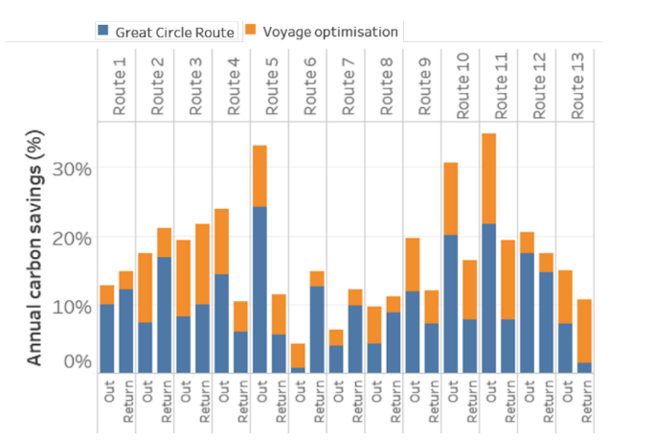
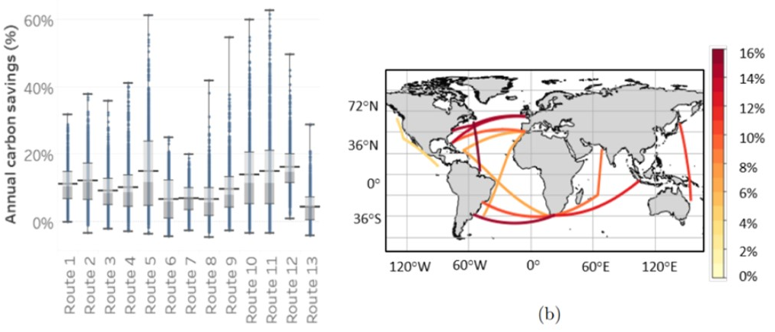
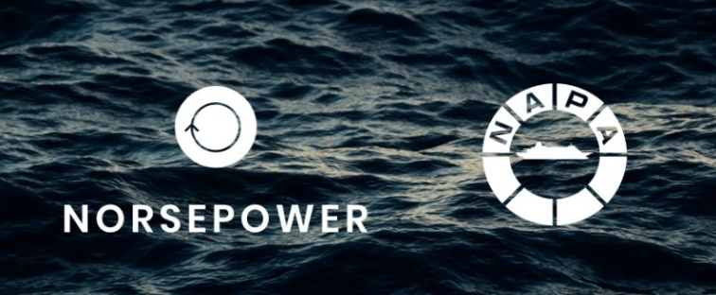
Combination with Voyage Optimization
Independent studies have proven, that the combination of voyage optimization and wind propulsion provides significantly increased performance potential.
Norsepower is collaborating with NAPA, the global maritime software, services and data analysis expert.
A more detailed study for the target vessel can be carried out later.
Source: James C Mason, “Quantifying voyage optimisation with wind-assisted ship propulsion: a new climate mitigation strategy for shipping”, The University of Manchester, 2021

Slide 19
Indicative pricing & business case calculation

Slide 20
Indicative CAPEX and OPEX
CAPEX
Norsepower scope of supply – Indicative price: {simulationResults.rotorSailsSummary.sumPrice | toFixed:0 | thousandsSeparator} USD
    Rotor Sail units assembled, tested and ready for installation. Delivery EXW 2026, Dafeng, China.
    Norsepower Control ™ automation system
    Project management, installation supervision and commissioning
Not in Norsepower scope of supply – Expected costs of additional {simulationInput.caseStudy.additionalCostPercentage * 100}% to the Norsepower CAPEX.
    Manufacturing and installation of the foundations.
    Installation of cabling and power hook-up.
    Mechanical installation work.
    Transportation to the installation location
OPEX
Norsepower Service Agreement – Indicative price: {simulationResults.rotorSailsSummary.sumMaintenancePrice | toFixed:0 | thousandsSeparator} USD/year
    All wear parts.
    Remote monitoring of the sails operation. Monthly reports with KPIs of the sails performance and availability.
    Remote expert support for possible troubleshooting and corrective maintenance work.
    Discounts in additional services, such as spare parts and service visits.
    Full scope of the NP Remote Service Agreement can be provided as per customer´s request.

Slide 21
Leasing Model
Alternative: Leasing agreement (Owned by Leasing JV and leased to Customer)
A leasing option can be offered for the rotor sail with the following main terms:
  Lease term is in minimum 5 years. Fixed monthly payments are made as agreed.
  After the lease term the customer has the option of
    i) purchasing the rotor sails with a pre-agreed price or
    ii) extending the lease term (subject to lease extension agreement).
  The lease may cover not only rotor sails but also foundation etc. which remains on the ship.
Next Steps: Information sharing with Mizuho Leasing and Iino Lines
In order to provide indicative proposal of leasing fee, we shall disclose outline of project (type and number of rotor sails etc.) to Mizuho Leasing and Iino Lines.
Company name, address and registration number will be requested for preparing the leasing proposal.
Please inform us in case you don’t want us to share information with Mizuho Leasing or Iino Lines.
Further information may be requested.

Slide 22
Net savings calculation
 | Low fuel cost scenario {simulationResults.fuelPrice.fuelCostSavingMinFuel.fuelPrice} USD/ton | High fuel cost scenario {simulationResults.fuelPrice.fuelCostSavingMaxFuel.fuelPrice} USD/ton
Fuel cost saving (USD/year) | {simulationResults.fuelPrice.fuelCostSavingMinFuel.fuelCostSaving | toNearest:1000 | thousandsSeparator} | {simulationResults.fuelPrice.fuelCostSavingMaxFuel.fuelCostSaving | toNearest:1000 | thousandsSeparator}
EU ETS saving (USD/year) | {simulationResults.combinedSavings.EUETSSavings | toNearest:1000 | thousandsSeparator}
FuelEU saving (USD/year) | {simulationResults.GHG.monetaryBenefit.usd | toNearest:1000 | thousandsSeparator}
Remote support (USD/year) | - {simulationResults.rotorSailsSummary.sumMaintenancePrice | toNearest:1000 | thousandsSeparator}
Total net annual saving (USD/year) | {simulationResults.fuelPrice.fuelCostSavingMinFuel.cumulativeNetAnnualSavings[0] | toNearest:1000 | thousandsSeparator} | {simulationResults.fuelPrice.fuelCostSavingMaxFuel.cumulativeNetAnnualSavings[0] | toNearest:1000 | thousandsSeparator}

Slide 23
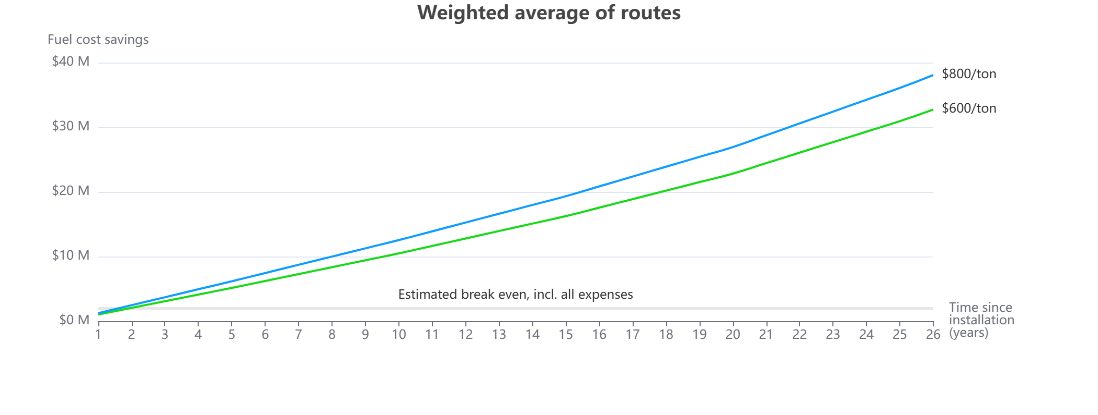
Business case – Net Present Values
{simulationResults.fuelPrice.fuelCostSavingMinFuel.fuelPrice} USD/ton Payback time: {simulationResults.fuelPrice.fuelCostSavingMinFuel.paybackPeriod | toFixed:2} years – discount rate {simulationInput.caseStudy.discountRate} %
25 years cumulative savings: {simulationResults.fuelPrice.fuelCostSavingMinFuel.cumulativeNetAnnualSavings[25] / 1000000 | toFixed:1} Million USD
{simulationResults.fuelPrice.fuelCostSavingMaxFuel.fuelPrice} USD/ton Payback time: {simulationResults.fuelPrice.fuelCostSavingMaxFuel.paybackPeriod | toFixed:2} years – discount rate {simulationInput.caseStudy.discountRate} %
25 years cumulative savings: {simulationResults.fuelPrice.fuelCostSavingMaxFuel.cumulativeNetAnnualSavings[25] / 1000000 | toFixed:1} Million USD

Slide 24
Suggested next steps

Slide 25
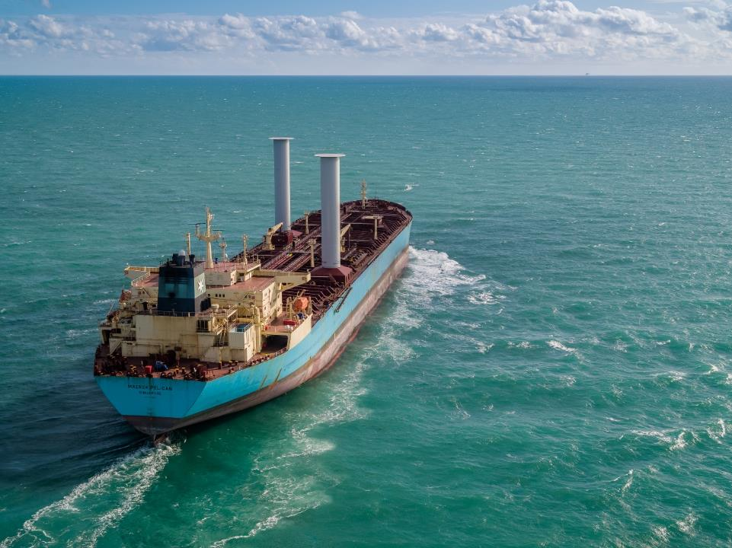
Suggested next steps
Review the case study together in video meeting.
More detailed technical analysis regarding locations, integration to the deck/hull structures and stability.
Offer for an agreed configuration
and scope.
Mutually beneficial co-operation leading to fleet-wide agreement.

Slide 26
Thank you !
For more information contact us at sales@norsepower.com or visit www.norsepower.com

