Slide 1
Case study for a Norsepower Rotor Sails™ for {simulationInput.caseStudy.company} / {simulationInput.ship.name}
{date}

Slide 2
Contents
Executive summary
Fuel savings
Indicative pricing & business case
Energy efficiency regulation
Suggested next steps
Appendix

Slide 3
Executive Summary
What did we find out and how?

Slide 4
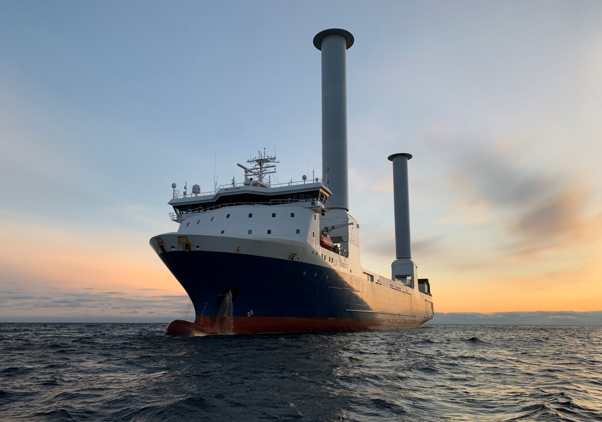
Executive Summary
Norsepower is the leading simulator expert on mechanical sails and has the best global wind data sources.
According to our simulations Norsepower Rotor Sails™ will bring substantial benefits on:
Operational costs
Environmental impact
Regulatory compliance
This case study provides details on all the above.
Norsepower Rotor Sails™
on SC Connector, 2023

Slide 5
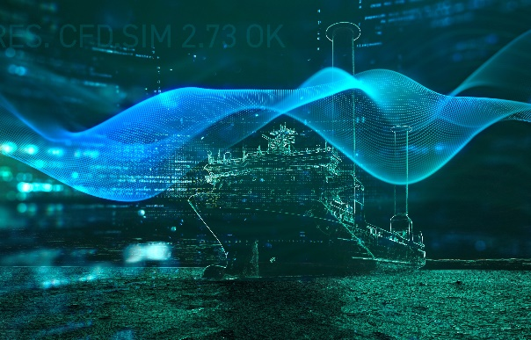
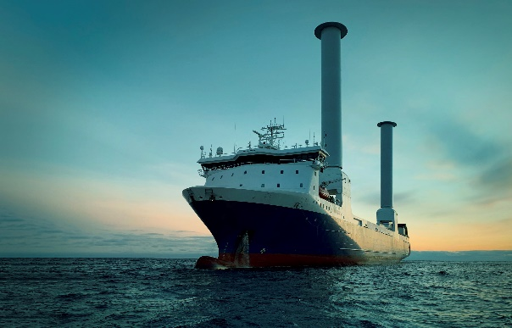
Executive Summary
Norsepower performance simulator has undergone extensive testing on multiple real-life installations with good results.
Simulation based on 20 years of European Union’s Space program wind data, IMO EEDI guidelines, and
the verified performance results from existing installations.
Operational profile and vessel parameters provided by {simulationInput.caseStudy.company}. More details on page 10.
Simulations for specified route(s) and Global shipping routes were conducted.
+
=
High-quality real-life data
Advanced simulations
Predicted results in reality

Slide 6
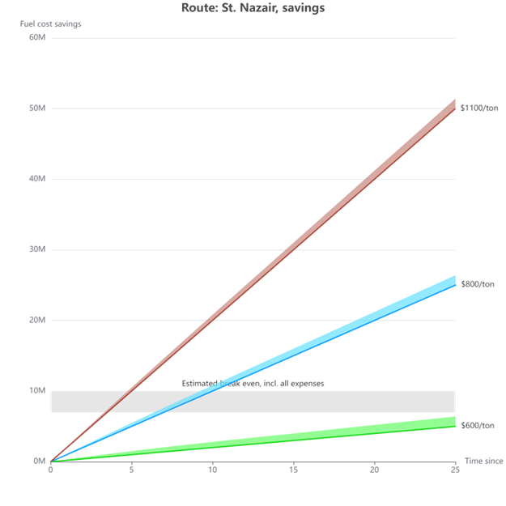
Executive Summary
Fuel price scenarios:
incl. carbon price
fuel only
The expected capex for the proposed configuration is {simulationResults.rotorSailsSummary.sumPrice | toFixed:0 | thousandsSeparator} USD.
The expected annual fuel savings are up to {simulationResults.maxAnnualFuelSavingsInTons | toFixed:0 } tons.
Operational cost savings up to {simulationResults.maxFuelPrice | toNearest:1000 | thousandsSeparator} USD per year.
Payback period of {simulationResults. paybackPeriodYears} years.

Slide 7
Suggested configuration with Norsepower Rotor Sails™
{#simulationInput.caseStudy.rotorSails}{amountText} {height}m x {diameter}m Norsepower Rotor Sails™ on {type} foundations{/simulationInput.caseStudy.rotorSails}.
Weight, space, stability and load carrying structures to be checked.
Ship length: {simulationInput.ship .length | toFixed:1} m
Beam: {simulationInput.ship.width | toFixed:1} m
Laden draft: {simulationInput.ship.ladenDraft | toFixed:1} m
Ballast draft: {simulationInput.ship. ballastDraft | toFixed:1} m
Installation height: {simulationInput.ship. installationHeight | toFixed:1} m
Preliminary sketch: Vessel with {#simulationInput.caseStudy.rotorSails}{amountText} {height}m x {diameter}m {/simulationInput.caseStudy.rotorSails}Norsepower Rotor Sail™

Slide 8
Input
Data behind

Slide 9
Parameters used in the simulations
Parameters
Total propulsion efficiency [%] | {(simulationInput.ship.propulsionEfficiency | toFixed:1) * 100}
Time-at-sea [%] | {(simulationInput.caseStudy.timeAtSeaRatio | toNearest:0.05) * 100}
Service speed laden [knots] | {simulationInput.ship.ladenServiceSpeed | toFixed:1}
Service speed ballast [knots] | {simulationInput.ship.ballastServiceSpeed | toFixed:1}
Installation height [m] | {simulationInput.ship. installationHeight | toFixed:1}
Laden draft [m] | {simulationInput.ship.ladenDraft | toFixed:1}
Ballast draft [m] | {simulationInput.ship. ballastDraft | toFixed:1}
Prop. Power laden [kW] | {simulationInput.ship.ladenServicePower | toFixed:0}
Prop. Power ballast [kW] | {simulationInput.ship.ballastServicePower | toFixed:0}
SFOC [g/kWh] | {simulationInput.ship.sfoc | toFixed:0}

Slide 10
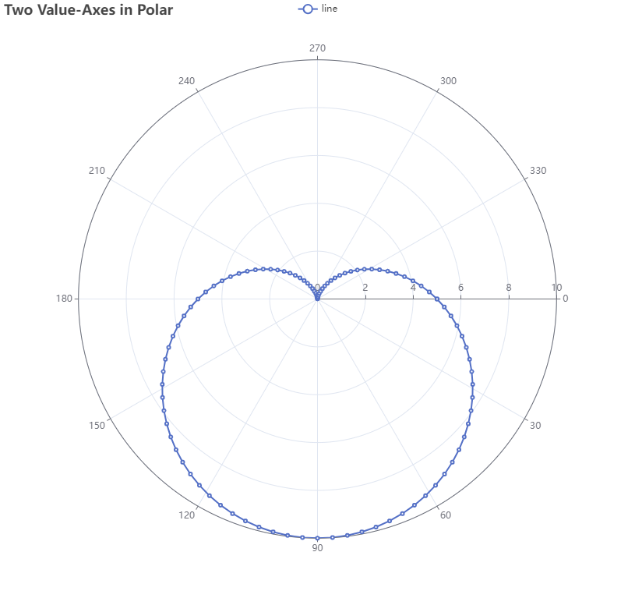
Norsepower Rotor Sail™ Polar diagram
The main-engine equivalent power produced by {#simulationInput.caseStudy.rotorSails}{amountText} {height}m x {diameter}m {/simulationInput.caseStudy.rotorSails}Norsepower Rotor Sail{#simulationInput.caseStudy.rotorSails.length>1}s{/}™ increases with distance from the center and true wind speed is represented by colors as indicated in the legend. True wind angle is shown in the circumference, with 0 degrees marking the ship’s heading.
Parameters:
Service speed: {simulationInput.ship.ladenServiceSpeed| toFixed:0} knots
Assumed total propulsion efficiency: {simulationInput.ship.propulsionEfficiency} (= towing power/brake power)
Examples of the maximum thrust of one Rotor Sail expressed as the propulsion power equivalent:
{simulationResults.polarRowMax | toFixed:0} kW (10 m/s wind speed)
{simulationResults.polarAllMax | toFixed:0} kW maximum (25 m/s)

Slide 11
Results in detail
Suggestions, Business case & Sustainability calculations

Slide 12
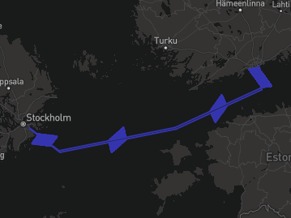
Savings vary along the different legs of route: {name}
{:simulationResults.routes}
{#legendNumbers}
{.} kW
{/legendNumbers}
Colors indicate the average savings potential on given area

Slide 13
Results in detail
Estimated annual fuel savings for {simulationInput.caseStudy.company} are {simulationResults.maxAnnualFuelSavingsInTons | toFixed:0 } tons of {simulationInput.ship.fuelType.abbreviation} with {#simulationInput.caseStudy.rotorSails}{amountText} {height}m x {diameter}m {/simulationInput.caseStudy.rotorSails}Norsepower Rotor Sail{#simulationInput.caseStudy.rotorSails.length>1}s{/}™ .
The wind conditions on the simulated route are favorable.
Norsepower Rotor Sails™ save {simulationResults.minMaxAnnualFuelSavingsInTons} tons of fuel per year
{simulationResults. maxAnnualCO2SavingsInTons| toFixed:0} tons CO₂ emissions reducted!
1860 tons/year
2065 tons/year

Slide 14
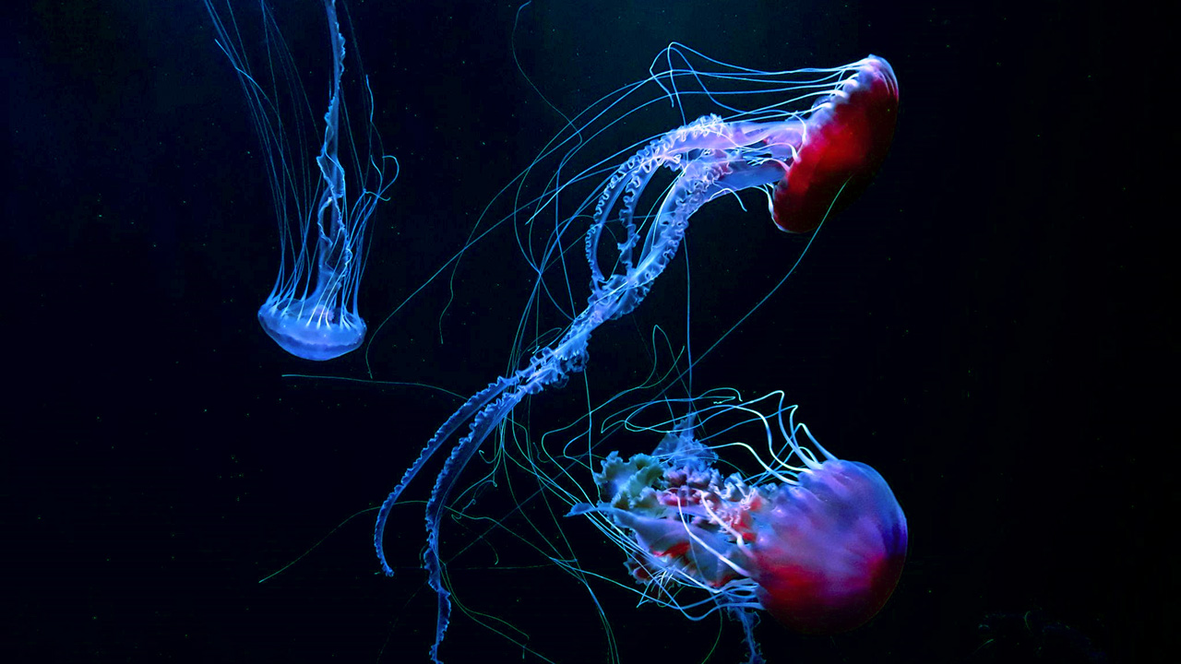
Considerable annual fuel savings and CO₂ reduction
{:simulationResults.routes}
{name} | {simulationInput.ship.ladenServiceSpeed | toFixed:1} kn
Norsepower Rotor Sail™ model | {#simulationInput.caseStudy.rotorSails}{amountText} {height}m x {diameter}m {/simulationInput.caseStudy.rotorSails}
Number of products | {simulationResults.rotorSailsSummary.amount | toFixed:0}
Average net savings, kW | {combinedRouteSavings.averageNetSavings| toFixed:0}
Average net savings, % | {combinedRouteSavings.averageNetSavingsPercentage|toFixed:1}
Average power consumption, kW | {combinedRouteSavings.averagePowerConsumption|toFixed:0}
Annual fuel savings on specific route, Tons | {combinedRouteSavings.annualFuelSavingsInTons|toFixed:0}
Annual CO2 reduction on specific route, Tons | {combinedRouteSavings.annualCO2SavingsInTons|toFixed:0}

Slide 15
Considerable annual fuel savings and CO₂ reduction
Global average | {simulationInput.ship.eediServiceSpeed | toFixed:1} kn
Norsepower Rotor Sail™ model | {#simulationInput.caseStudy.rotorSails}{amountText} {height}m x {diameter}m {/simulationInput.caseStudy.rotorSails}
Number of products | {simulationResults.rotorSailsSummary.amount | toFixed:0}
Average net savings, kW | {simulationResults.EEDIRouteSavings.averageNetSavings | toFixed:0 }
Average net savings, % | {simulationResults.EEDIRouteSavings.averageNetSavingsPercentage|toFixed:1}
Average power consumption, kW | {simulationResults.EEDIRouteSavings.averagePowerConsumption|toFixed:0}
Annual fuel savings on specific route, Tons | {simulationResults.EEDIRouteSavings.annualFuelSavingsInTons|toFixed:0}
Annual CO2 reduction on specific route, Tons | {simulationResults.EEDIRouteSavings.annualCO2SavingsInTons|toFixed:0}

Slide 16
FuelEU Maritime regulatory benefit (1/2)
FuelEU reward factor f_{Wind} :
EEDI/EEXI available effective power: f_{eff} * P_{eff} = P_{wind} = {simulationResults.EEDIReduction | toFixed:0 } kW.
EEDI/EEXI Propulsion power of the vessel: P_{ME} = P_{Prop} = {simulationInput.ship.pme | toFixed:0 } kW.
P_{wind}/P_{prop} = {simulationResults.GHG.ratio | toFixed:3 } ⇒ reward factor f_{Wind} = {simulationResults.GHG.fwind} .
GHG Intensity without wind propulsion using {simulationInput.ship.fuelType.abbreviation} = {simulationInput.ship.fuelType.ghgIntensity} gCO₂eq/MJ.
GHG Intensity with Norsepower rotor sails = GHG Intensity * f_{Wind} = {simulationResults.GHG.intensityWithRotorSails | toFixed:2 } CO_{2eq}/MJ.
GHG Intensity target for {simulationResults.GHG.target.timespan}: {simulationResults.GHG.target.intensity} gCO_{2eq}/MJ.
GHG Intensity balance without wind propulsion = Target – GHG intensity = {simulationResults.GHG.balance.valueWithoutWindPropulsion | toFixed:2} gCO₂eq/MJ
GHG Intensity balance with Norsepower rotor sails = Target – GHG intensity = {simulationResults.GHG.balance. valueWithRotorSails | toFixed:2} gCO₂eq/MJ

Slide 17
FuelEU Maritime regulatory benefit (2/2)
Without wind propulsion:
Fuel consumption in EU/EEA area considering operational profile: {simulationResults.GHG.fuelConsumedInEuropeInTons | toFixed:0 } tons of {simulationInput.ship.fuelType.abbreviation}.
Compliance balance [gCO2eq] = (GHG Intensity balance) * fuel energy [MJ] = {simulationResults.GHG.complianceBalance.valueWithoutWindPropulsion | toFixed:0 | thousandsSeparator} gCO2eq
With Norsepower rotor sails:
Fuel consumption in EU/EEA area considering operational profile and rotor sail fuel savings: {simulationResults.GHG.fuelConsumedInEuropeInTons - simulationResults.GHG.fuelSavedByRotorSailsInTons| toFixed:0 } tons of {simulationInput.ship.fuelType.abbreviation}.
Compliance balance [gCO2eq] = (GHG Intensity balance) * fuel energy [MJ] = {simulationResults.GHG.complianceBalance.valueWithRotorSails | toFixed:0 | thousandsSeparator} gCO2eq
Exceeding the GHG intensity target is penalized:
FuelEU penalty without wind propulsion = {simulationResults.GHG.penalty.valueWithoutWindPropulsion | toFixed:0 | thousandsSeparator} EUR
FuelEU penalty with wind propulsion = {simulationResults.GHG.penalty.valueWithRotorSails | toFixed:0 | thousandsSeparator} EUR
Overcompliance can be pooled to avoid penalties on other vessels:
Pooling benefit without wind propulsion = {simulationResults.GHG.poolingBenefit.valueWithoutWindPropulsion | toFixed:0 | thousandsSeparator} EUR
Pooling benefit with wind propulsion = {simulationResults.GHG.poolingBenefit.valueWithRotorSails | toFixed:0 | thousandsSeparator} EUR
Total annual monetary FuelEU benefit from rotor sails:
Pooling benefit + avoided penalty = {simulationResults.GHG.monetaryBenefit.eur | toFixed:0 | thousandsSeparator} EUR/year = {simulationResults.GHG.monetaryBenefit.usd | toFixed:0 | thousandsSeparator} USD/year

Slide 18
Indicative pricing & business case
Some preliminary price range information

Slide 19
Indicative pricing of the following Norsepower Rotor Sails™:
{#simulationInput.caseStudy.rotorSails}
{amountText} {height}m x {diameter}m
{/simulationInput.caseStudy.rotorSails}
The typical scope of supply
Rotor Sail units assembled, tested and ready for installation
Norsepower Control ™ automation system
Project management, installation supervision
Commissioning
The price estimate, {simulationResults.rotorSailsSummary.amount} units: {simulationResults.rotorSailsSummary.sumPrice | toFixed:0 | thousandsSeparator} USD
Norsepower Service Agreement (Silver level) per vessel, includes:
Spare parts.
Remote monitoring with monthly report.
Remote expert support for possible troubleshooting and corrective maintenance work.
One day of training for ship’s crew and technical superintendents during the Rotor Sail installation and commissioning phase.
The price estimate for one ship: {simulationResults.rotorSailsSummary.sumMaintenancePrice | toFixed:0 | thousandsSeparator} USD/year.

Slide 20
Other project costs (Not in Norsepower scope of supply)
Manufacturing and installation of foundations.
Installation of cabling and power hook-up.
Mechanical installation work.
Transportation to the installation location.
Additional cost expected to be about 20% of the total CAPEX.

Slide 21
Norsepower Rotor Sails™ save even more in high fuel cost scenarios
{:simulationResults.routes}
Discounted cumulative fuel cost savings of {#simulationInput.caseStudy.rotorSails}{amountText} {height}m x {diameter}m Norsepower Rotor Sails™ on {type} foundations{/simulationInput.caseStudy.rotorSails}
Fuel price scenarios:
incl. carbon price
fuel only

Slide 22
Energy efficiency regulation

Slide 23
EEDI / EEXI
Norsepower Rotor Sails™ support EEXI/EEDI compliance.
As an indication, Rotor Sails reduce the index by about {simulationResults.GHG.ratio * 100 | toFixed:1}%.
Detailed EEDI/EEXI impact can be assessed upon request.
More details on page {EEDIDetailsPageNumber}.

Slide 24
Other regulation (CII, FuelEU, ETS, ..)
Norsepower Rotor Sails support the compliance on operational efficiency regulation, such as CII.
Expected CII reduction up to {simulationResults.maxAverageNetSavingsPercentage | toFixed:1 }%, can be further improved with Voyage Optimization.
This corresponds to {simulationResults.yearsOfExtendedCIICompliance | toFixed:1} years of extended CII compliance.
European Union is imposing regulation on emission levels (EU ETS= Emission trading scheme) and fuel type (FuelEU Maritime) of EU shipping. Ships with Rotor Sails will be in beneficial position in both regulation.

Slide 25
Suggested next steps
Here’s how we would like to continue

Slide 26
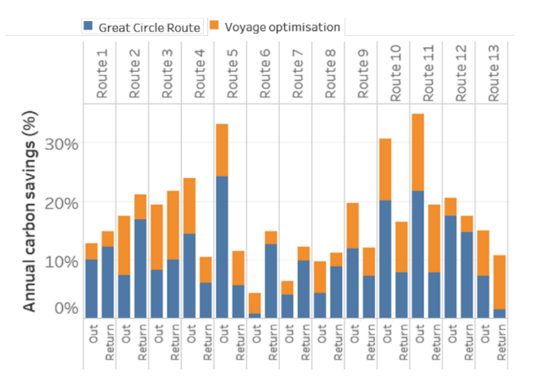
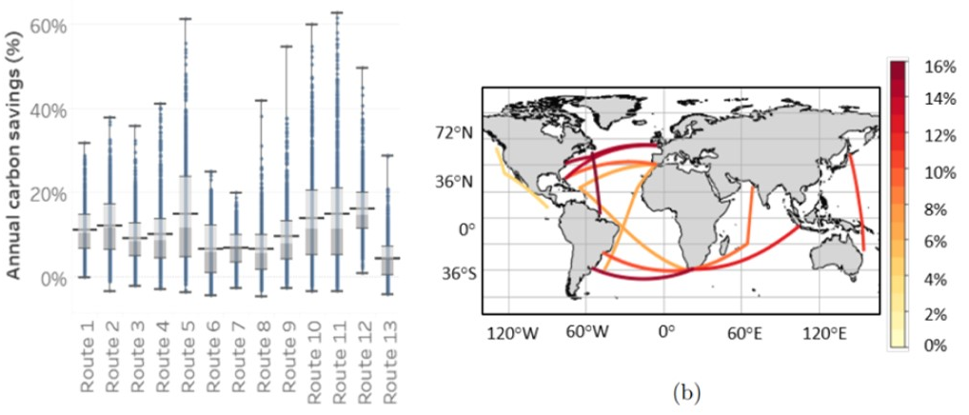
Considerable upside with Voyage Optimization
Independent studies have proven, that the combination of voyage optimization and wind propulsion provides significantly increased performance potential.
Norsepower is collaborating with NAPA, the global maritime software, services and data analysis expert.
A more detailed study for the target vessel can be carried out later.
Source: James C Mason, “Quantifying voyage optimisation with wind-assisted ship propulsion: a new climate mitigation strategy for shipping”, The University of Manchester, 2021

Slide 27
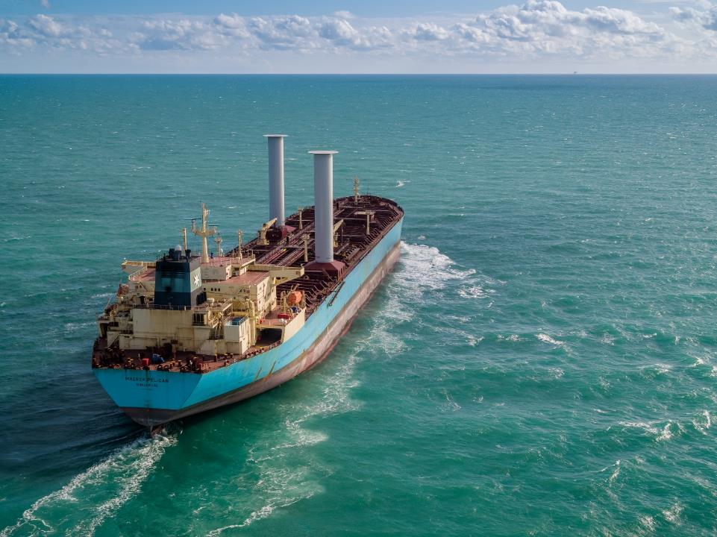
Suggested next steps
Review the case study together in video meeting.
More detailed technical analysis regarding locations, integration to the deck/hull structures and stability.
Offer for an agreed configuration and scope.
Mutually beneficial co-operation leading to fleet-wide agreement.

Slide 28
Thank you {simulationInput.caseStudy.company} !
For more information contact us at sales@norsepower.com or visit www.norsepower.com

Slide 29
Appendix: Input data and performance simulations explained
Methodology & data

Slide 30
Norsepower Rotor Sails™ science: Magnus effect
Norsepower Rotor Sail™ rotated:
In e.g. curve balls in football, tennis & golf.
Spinning object + relative wind -> pressure differential -> thrust at 90⁰ angle to the wind
Norsepower Rotor Sails™ harness wind to maximise ship’s fuel efficiency.
Unique technology: high-tech materials, intelligent automation software & relentless testing in real life circumstances.
Football curveball kicked:
Wind
Thrust
Thrust
Electrical motor
Wind
Magnus
force
Norsepower Rotor Sail™ uses 1x of the ship’s electricity to rotate a cylinder in the wind. Rotating cylinder produces ~14x physical thrust.
Rotation
Magnus force
Rotation
Rotation
Right of center kick

Slide 31
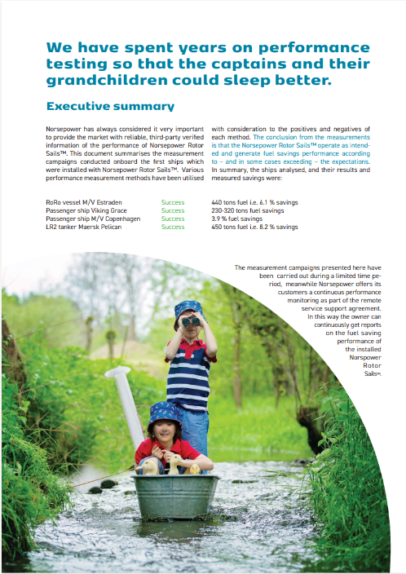
Accurate & proven simulation method
Annual fuel saving potential estimated for a specific route:
Route divided into <400 km legs.
Probabilities of wind conditions (wind speed & direction) assessed from 20 years of European Union’s Space programme global wind data.
For each wind condition, the product performance model is used to estimate the savings.
Annual expected savings potential is the result of
Probability of wind conditions
Estimated savings in them
Leg-savings are aggregated to yield annual average savings.
Years of performance measurements onboard existing ships have proven the methodology.
Schematic of the simulation route
Leg
Wind data point
Waypoint

Slide 32
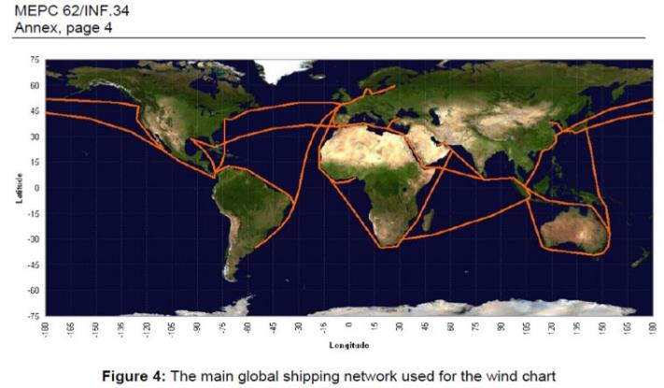
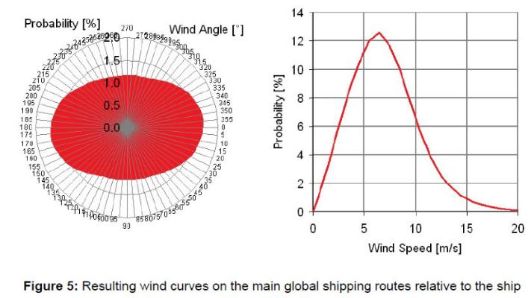
Simulation and wind data
Simulation based on 20 years of European Union’s Space program ERA5 wind data.
The wind data used in the simulation of the global average is based on IMO’s MEPC 62/INF.34 (Marine Environmental Protection Committee) report Annex “Global Wind Specification along the Main Global Shipping Routes to be applied in the EEDI calculation of wind propulsion systems”.
Thrust forces by the Norsepower Rotor Sails™ are calculated based on the verified performance results of reference fleet.
Thrust forces are converted to main engine equivalent power by method described in MEPC.1 – Circ.815.

Slide 33
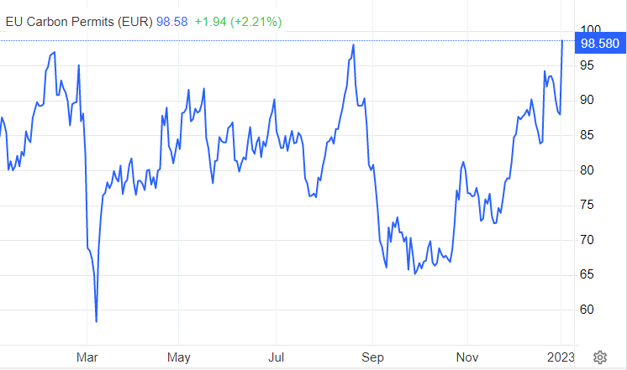
Business case calculation
The business case is calculated using the discounted cashflow method (Net Present Value)
The calculation is shown for a 25-year lifetime of the ship and assumes remote service support fees as on page 17
Some scenarios include carbon in the operational costs with a constant price of USD {simulationResults.co2PriceValue}/CO2-ton.
For reference, on the right are shown the EU ETS CO2 prices for the year 2022
The discounted operational cost savings are shown in different price scenarios
The assumed discount rate is {simulationInput.caseStudy.discountRate}%
Source: tradingeconomics.com

Slide 34
EEDI / EEXI
The EEDI / EEXI calculation directly considers Rotor Sails as an advantage.
Rotor Sails are considered as an energy saving device.
The calculation guidelines to determine the index improvement are given in MEPC.1-Circ.896.
Exact determination of the index improvement requires detailed an aerodynamic analysis which Norsepower can support with.
An indicative reduction figure is given based on simplified calculation.

Slide 35
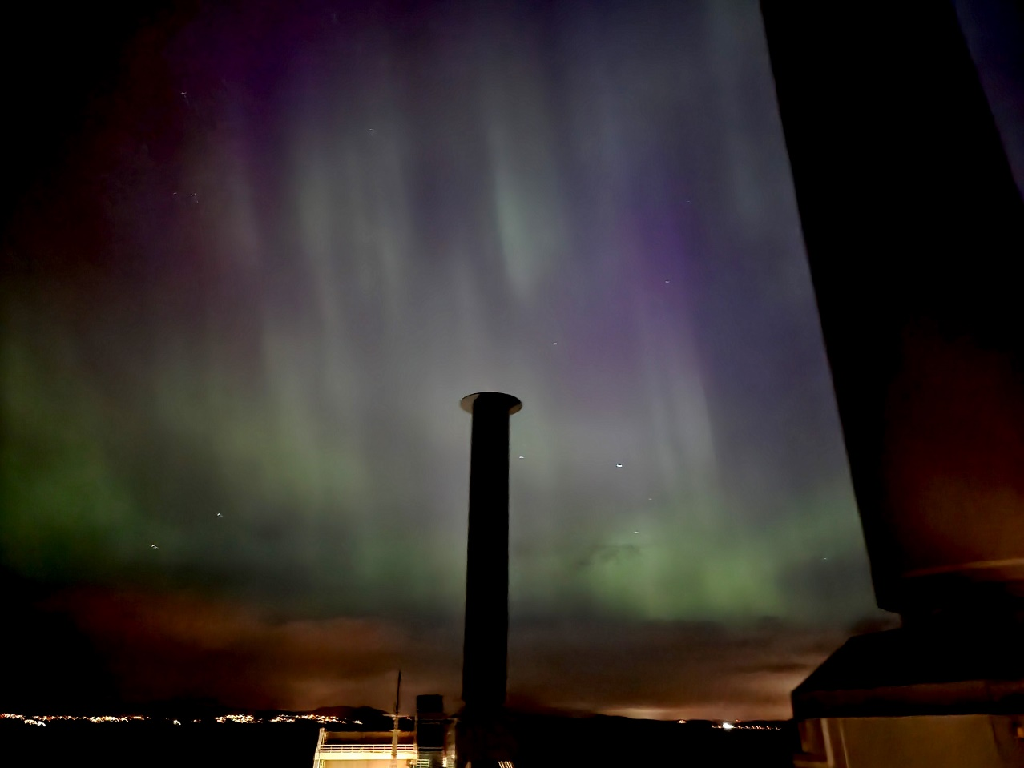
We are here to help
Our sales and tech teams consist of leading mechanical sails experts and are at your disposal. Please contact us if you have any further questions.
sales@norsepower.com
Thank you very much!

Slide 36
Thank you!
www.norsepower.com

