Slide 1
Case study for {simulationInput.caseStudy.company} / {simulationInput.ship.name}
{#simulationInput.caseStudy.rotorSails}{amountText} {height}m x {diameter}m Norsepower Rotor Sails™ on {type} foundations{/simulationInput.caseStudy.rotorSails}.
{date}

Slide 2
Contents
Executive summary
Fuel saving results
Energy efficiency regulation
Indicative pricing & business case
Suggested next steps
Appendix

Slide 3
Executive Summary

Slide 4
Introduction
Norsepower has carried out a customized performance, regulatory compliance and business case study of an installation project of Norsepower Rotor Sails™ in your vessel. Our case study is based on:
Our Norsepower performance simulator
Your ship specific technical and operational profile.
20 years of historical global wind data from European Union Space program
Guidelines from IMO annexes, and framework from EU regulations
Norsepower performance simulator is a semi-empiric wind model which has been progressively tuned based on the thrust measurements collected from the operation of our sails in vessels around the world. These thrust measurements have been thoroughly validated by third-party verification entities.
A detailed description of how our case study is carried out can be found in the document “Norsepower Case Study Appendix”.

Slide 5
Executive Summary
The expected capex for the proposed configuration is {simulationResults.rotorSailsSummary.sumPrice | toFixed:0 | thousandsSeparator} USD.
The expected annual fuel savings are {simulationResults.combinedSavings.averageRouteFuelSavings | toFixed:0 | thousandsSeparator} tons.
Total net savings from {simulationResults.fuelPrice.fuelCostSavingMinFuel.fuelCostSaving | toNearest:1000 | thousandsSeparator} to {simulationResults.fuelPrice.fuelCostSavingMaxFuel.fuelCostSaving | toNearest:1000 | thousandsSeparator} USD per year.
Payback period from {simulationResults.fuelPrice.fuelCostSavingMaxFuel.paybackPeriod | toFixed:2} to {simulationResults.fuelPrice.fuelCostSavingMinFuel.paybackPeriod | toFixed:2} years.
Accumulated net savings of {simulationResults.fuelPrice.fuelCostSavingMaxFuel.cumulativeNetAnnualSavings[25] / 1000000 | toFixed:2 | thousandsSeparator} million/USD for the whole lifetime of the sails (25 years)

Slide 6
Proposed sails plan
{#simulationInput.caseStudy.rotorSails}{amountText} {height}m x {diameter}m Norsepower Rotor Sails™ on {type} foundations{/simulationInput.caseStudy.rotorSails}.
Weight, space, stability and load carrying structures to be checked.
Ship length: {simulationInput.ship .length | toFixed:1} m
Beam: {simulationInput.ship.width | toFixed:1} m
Laden draft: {simulationInput.ship.ladenDraft | toFixed:1} m
Ballast draft: {simulationInput.ship. ballastDraft | toFixed:1} m
Installation height: {simulationInput.ship. installationHeight | toFixed:1} m
Preliminary sketch: Vessel with {#simulationInput.caseStudy.rotorSails}{amountText} {height}m x {diameter}m {/simulationInput.caseStudy.rotorSails}Norsepower Rotor Sail™

Slide 7
Ship operation profile
Parameters
Total propulsion efficiency [%] | {(simulationInput.ship.propulsionEfficiency | toFixed:1) * 100}
Time-at-sea [%] | {(simulationInput.caseStudy.timeAtSeaRatio | toNearest:0.05) * 100}
Service speed laden [knots] | {simulationInput.ship.ladenServiceSpeed | toFixed:1}
Service speed ballast [knots] | {simulationInput.ship.ballastServiceSpeed | toFixed:1}
Fuel type | {simulationInput.ship.fuelType.abbreviation}
Prop. Power laden [kW] | {simulationInput.ship. ladenServicePower | toFixed:0}
Prop. Power ballast [kW] | {simulationInput.ship.ballastServicePower | toFixed:0}
SFOC [g/kWh] | {simulationInput.ship.sfoc | toFixed:0}

Slide 8
Fuel saving results

Slide 9
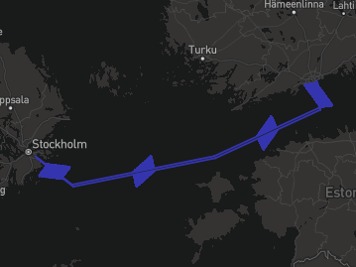
{:simulationResults.routes}
Performance on route: {name}
{#legendNumbers}
{.} kW
{/legendNumbers}
{name} | {simulationInput.ship.ladenServiceSpeed | toFixed:1} kn
Average net savings, kW | {combinedRouteSavings.averageNetSavings| toFixed:0}
Average net savings, % | {combinedRouteSavings.averageNetSavingsPercentage|toFixed:1}
Average power consumption, kW | {combinedRouteSavings.averagePowerConsumption|toFixed:0}
Annual fuel savings on specific route, Tons | {combinedRouteSavings.annualFuelSavingsInTons|toFixed:0}
Annual CO2 reduction on specific route, Tons | {combinedRouteSavings.annualCO2SavingsInTons|toFixed:0}

Slide 10
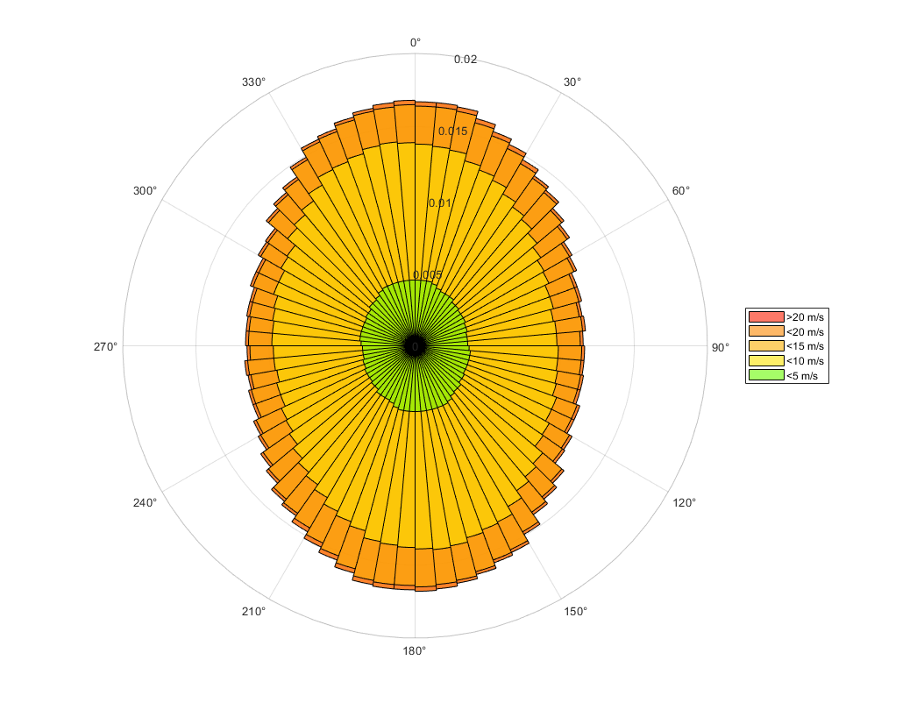
Performance in Global Average conditions
Global average | {simulationInput.ship.eediServiceSpeed | toFixed:1} kn
Average net savings, kW | {simulationResults.globalAverageRouteSavings.averageNetSavings | toFixed:0 }
Average net savings, % | {simulationResults.globalAverageRouteSavings.averageNetSavingsPercentage|toFixed:1}
Average power consumption, kW | {simulationResults.globalAverageRouteSavings.averagePowerConsumption|toFixed:0}
Annual fuel savings on specific route, Tons | {simulationResults.globalAverageRouteSavings.annualFuelSavingsInTons|toFixed:0}
Annual CO2 reduction on specific route, Tons | {simulationResults.globalAverageRouteSavings.annualCO2SavingsInTons|toFixed:0}
Global average wind conditions based in MEPC.1/Circ.815

Slide 11
Comparison of savings per route
Weighted average of the simulated routes
Average net savings for multiple routes, kW | {simulationResults.combinedSavings.averageRouteNetSavings | toFixed:0 }
Average fuel savings for multiple routes, Tons | {simulationResults.combinedSavings.averageRouteFuelSavings|toFixed:1}
Average Main engine power for multiple routes, kW | {simulationResults.combinedSavings.averageRouteMainEnginePower|toFixed:0}
Average Main Engine fuel consumption for multiple routes, Tons | {simulationResults.combinedSavings.averageRouteMainEngineFuelConsumption|toFixed:0}
Average Savings percentage for multiple routes, % | {simulationResults.combinedSavings.averageRouteNetSavingsPercentage * 100 |toFixed:1}
Annual fuel savings (tons/year)
1860 tons/year
2065 tons/year

Slide 12
Energy efficiency regulation

Slide 13
FuelEU Maritime regulatory benefit (1/2)
FuelEU reward factor f_{Wind} :
EEDI/EEXI available effective power: f_{eff} * P_{eff} = P_{wind} = {simulationResults.EEDIReduction | toFixed:0 } kW.
EEDI/EEXI Propulsion power of the vessel: P_{ME} = P_{Prop} = {simulationInput.ship.pme | toFixed:0 } kW.
P_{wind}/P_{prop} = {simulationResults.GHG.ratio | toFixed:3 } ⇒ reward factor f_{Wind} = {simulationResults.GHG.fwind} .
GHG Intensity without wind propulsion using {simulationInput.ship.fuelType.abbreviation} = {simulationInput.ship.fuelType.ghgIntensity} gCO₂eq/MJ.
GHG Intensity with Norsepower rotor sails = GHG Intensity * f_{Wind} = {simulationResults.GHG.intensityWithRotorSails | toFixed:2 } CO_{2eq}/MJ.
GHG Intensity target for {simulationResults.GHG.target.timespan}: {simulationResults.GHG.target.intensity} gCO_{2eq}/MJ.
GHG Intensity balance without wind propulsion = Target – GHG intensity = {simulationResults.GHG.balance.valueWithoutWindPropulsion | toFixed:2} gCO₂eq/MJ
GHG Intensity balance with Norsepower rotor sails = Target – GHG intensity = {simulationResults.GHG.balance. valueWithRotorSails | toFixed:2} gCO₂eq/MJ

Slide 14
FuelEU Maritime regulatory benefit (2/2)
Without wind propulsion:
Fuel consumption in EU/EEA area considering operational profile: {simulationResults.GHG.fuelConsumedInEuropeInTons | toFixed:0 } tons of {simulationInput.ship.fuelType.abbreviation}.
Compliance balance [gCO2eq] = (GHG Intensity balance) * fuel energy [MJ] = {simulationResults.GHG.complianceBalance.valueWithoutWindPropulsion | toFixed:0 | thousandsSeparator} gCO2eq
With Norsepower rotor sails:
Fuel consumption in EU/EEA area considering operational profile and rotor sail fuel savings: {simulationResults.GHG.fuelConsumedInEuropeInTons - simulationResults.GHG.fuelSavedByRotorSailsInTons| toFixed:0 } tons of {simulationInput.ship.fuelType.abbreviation}.
Compliance balance [gCO2eq] = (GHG Intensity balance) * fuel energy [MJ] = {simulationResults.GHG.complianceBalance.valueWithRotorSails | toFixed:0 | thousandsSeparator} gCO2eq
Exceeding the GHG intensity target is penalized:
FuelEU penalty without wind propulsion = {simulationResults.GHG.penalty.valueWithoutWindPropulsion | toFixed:0 | thousandsSeparator} EUR
FuelEU penalty with wind propulsion = {simulationResults.GHG.penalty.valueWithRotorSails | toFixed:0 | thousandsSeparator} EUR
Overcompliance can be pooled to avoid penalties on other vessels:
Pooling benefit without wind propulsion = {simulationResults.GHG.poolingBenefit.valueWithoutWindPropulsion | toFixed:0 | thousandsSeparator} EUR
Pooling benefit with wind propulsion = {simulationResults.GHG.poolingBenefit.valueWithRotorSails | toFixed:0 | thousandsSeparator} EUR
Total annual monetary FuelEU benefit from rotor sails:
Pooling benefit + avoided penalty = {simulationResults.GHG.monetaryBenefit.eur | toFixed:0 | thousandsSeparator} EUR/year = {simulationResults.GHG.monetaryBenefit.usd | toFixed:0 | thousandsSeparator} USD/year

Slide 15
Other regulations
Rotor Sails reduce the EEXI/EEDI index by about {simulationResults.GHG.ratio * 100 | toFixed:1}%.
Detailed EEDI/EEXI impact can be assessed upon request.
Norsepower Rotor Sails support the compliance on operational efficiency regulation, such as CII.
Expected CII reduction up to {simulationResults.combinedSavings.averageRouteNetSavingsPercentage * 100 | toFixed:1 }%, which corresponds to {simulationResults.yearsOfExtendedCIICompliance | toFixed:1} years of extended CII compliance. It can be further improved with Voyage Optimization.

Slide 16
Indicative pricing & business case calculation

Slide 17
Indicative CAPEX and OPEX for the project
CAPEX
Norsepower scope of supply – Indicative price: {simulationResults.rotorSailsSummary.sumPrice | toFixed:0 | thousandsSeparator} USD
Rotor Sail units assembled, tested and ready for installation. Delivery EXW 2026, Dafeng, China.
Norsepower Control ™ automation system
Project management, installation supervision and commissioning
Not in Norsepower scope of supply – Expected costs of additional 20% to the Norsepower CAPEX.
Manufacturing and installation of the foundations.
Installation of cabling and power hook-up.
Mechanical installation work.
Transportation to the installation location
OPEX
Norsepower Service Agreement – Indicative price: {simulationResults.rotorSailsSummary.sumMaintenancePrice | toFixed:0 | thousandsSeparator} USD/year.
All wear parts.
Remote monitoring of the sails operation. Monthly reports with KPIs of the sails performance and availability.
Remote expert support for possible troubleshooting and corrective maintenance work.
Discounts in additional services
And many others features included

Slide 18
Net savings calculation
 | Low fuel cost scenario {simulationResults.fuelPrice.fuelCostSavingMinFuel.fuelPrice} USD/ton | High fuel cost scenario {simulationResults.fuelPrice.fuelCostSavingMaxFuel.fuelPrice} USD/ton
Fuel cost saving (USD/year) | {simulationResults.fuelPrice.fuelCostSavingMinFuel.fuelCostSaving | toFixed:0 | thousandsSeparator} | {simulationResults.fuelPrice.fuelCostSavingMaxFuel.fuelCostSaving | toFixed:0 | thousandsSeparator}
EU ETS saving (USD/year) | {simulationResults.combinedSavings.EUETSSavings | toFixed:0 | thousandsSeparator}
FuelEU saving (USD/year) | {simulationResults.GHG.monetaryBenefit.usd | toFixed:0 | thousandsSeparator}
Remote support (USD/year) | - {simulationResults.rotorSailsSummary.sumMaintenancePrice | toFixed:0 | thousandsSeparator}
Total net annual saving (USD/year) | {simulationResults.fuelPrice.fuelCostSavingMinFuel.cumulativeNetAnnualSavings[0] | toFixed:0 | thousandsSeparator} | {simulationResults.fuelPrice.fuelCostSavingMaxFuel.cumulativeNetAnnualSavings[0] | toFixed:0 | thousandsSeparator}

Slide 19
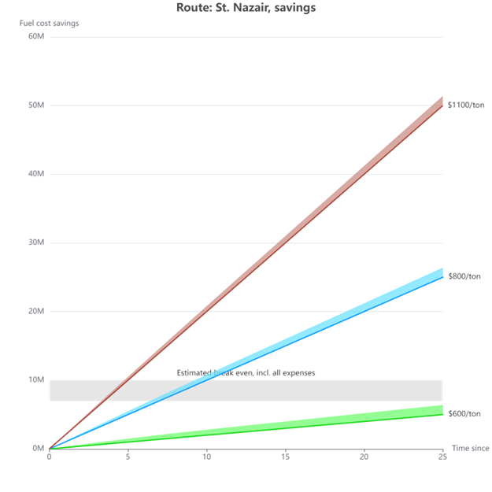
Business case – Net Present Values
{simulationResults.fuelPrice.fuelCostSavingMinFuel.fuelPrice} USD/ton Payback time: {simulationResults.fuelPrice.fuelCostSavingMinFuel.paybackPeriod | toFixed:2} years
25 years cumulative savings: {simulationResults.fuelPrice.fuelCostSavingMinFuel.cumulativeNetAnnualSavings[24] / 1000000 | toFixed:1} Million USD
{simulationResults.fuelPrice.fuelCostSavingMaxFuel.fuelPrice} USD/ton Payback time: {simulationResults.fuelPrice.fuelCostSavingMaxFuel.paybackPeriod | toFixed:2} years
25 years cumulative savings: {simulationResults.fuelPrice.fuelCostSavingMaxFuel.cumulativeNetAnnualSavings[24] / 1000000 | toFixed:1} Million USD

Slide 20
Suggested next steps

Slide 21
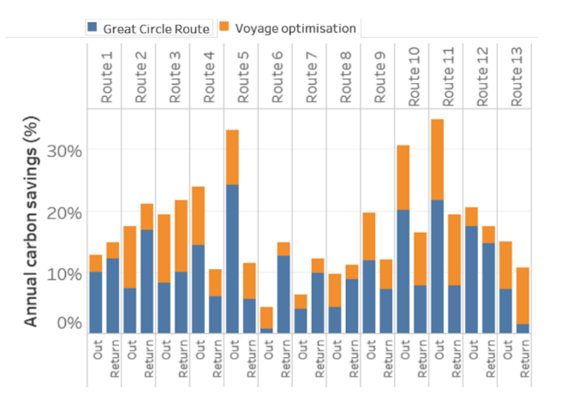
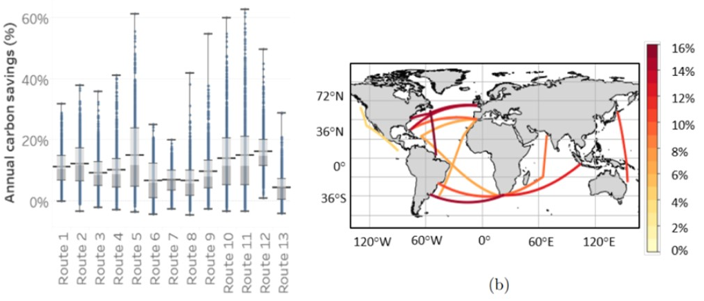
Considerable upside with Voyage Optimization
Independent studies have proven, that the combination of voyage optimization and wind propulsion provides significantly increased performance potential.
Norsepower is collaborating with NAPA, the global maritime software, services and data analysis expert.
A more detailed study for the target vessel can be carried out later.
Source: James C Mason, “Quantifying voyage optimisation with wind-assisted ship propulsion: a new climate mitigation strategy for shipping”, The University of Manchester, 2021

Slide 22
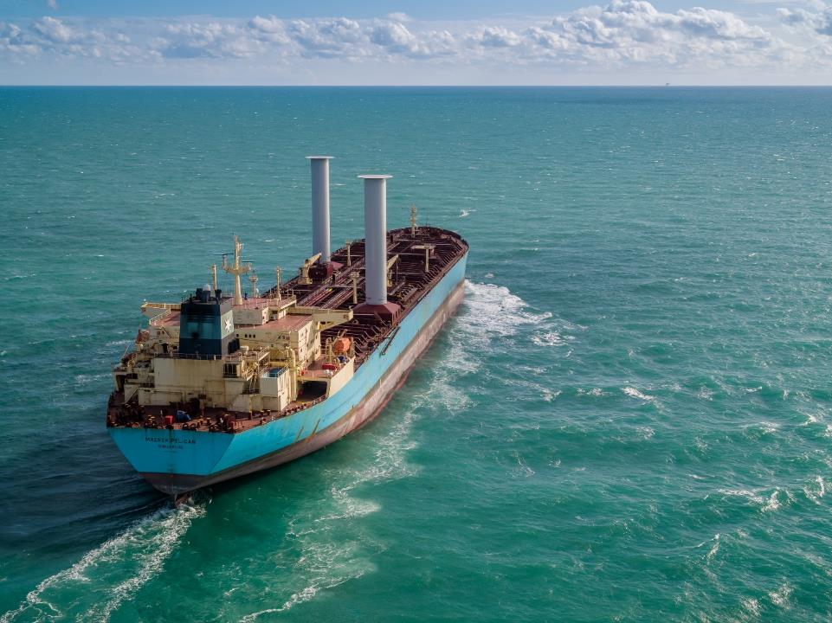
Suggested next steps
Review the case study together in video meeting.
More detailed technical analysis regarding locations, integration to the deck/hull structures and stability.
Offer for an agreed configuration and scope.
Mutually beneficial co-operation leading to fleet-wide agreement.

Slide 23
Thank you {simulationInput.caseStudy.company} !
For more information contact us at sales@norsepower.com or visit www.norsepower.com

